Slide 1
Spatial Informatics Final Presentation
Name: Ansh Chablani
Roll No.: 2022111031

Slide 2

Title and Description
Title: Optimal Trajectory Planning for a Mars Rover Using Spatial Data collected by Mars Orbiters
Description: This project aims to plan an optimal trajectory for a rover traveling between two selected sites. The rover trajectory is optimized by considering terrain difficulty, obstacles.

Slide 3
Objectives Achieved

Slide 4
Objectives Achieved
These are the objectives I achieved till mid evaluation.
Find and establish a suitable CRS for Mars. (CRS = Coordinate Reference System)
Find necessary data and extract out useful information from them.
Using a DTM of a particular region of Mars, find a suitable movement directions given a start point based on only the slope data. (dropped this method in the final submission)
Using the movement directions and the slope data, establish a means of finding a least cost trajectory given a start point. This establishes a good base over which I can put more constraints. (dropped this method in the final submission)

Slide 5
Objectives Achieved
These are the objectives I achieved after mid evaluation.
Implement a custom algorithm to find the shortest path from a start point and an end point.
Include checks and route the rover away from danger zones. Inculcate danger zones – deep craters, big rocks.
Affinity points: Include “via” points which need to be visited however from a distance. E.g. Craters, ice deposits, etc.
Inclusion and processing of the CRISM dataset. This includes identification of high concentration of ice deposits using image processing of a raster. This includes thresholding, morphological operations and Hough Circles.
3D visualizer for the HiRISE dataset with the path overlayed in 3D.

Slide 6
Objectives Achieved
These are the objectives I achieved after mid evaluation.
6. A simple robot that traverses the terrain.
7. *Accounting for local slope gradient. E.g., if the rover has a physical constraint of a tolerance of 30 degrees to climb a slope, it will only follow a trajectory that satisfies this constraint.

Slide 7
Data Used

Slide 8
Data: Source and Characteristics
MOLA (Mars Orbiter Laser Altimeter)​
Source: ​
MOLA data was collected by NASA's Mars Global Surveyor
​
Characteristics: ​
Purpose: Provides highly accurate elevation and topography data for Mars, essential for understanding the planet's surface structure and geological features.​
Data Type: Altimetric data, which measures the time it takes for a laser pulse to travel from the orbiter to the planet's surface and​

Slide 9
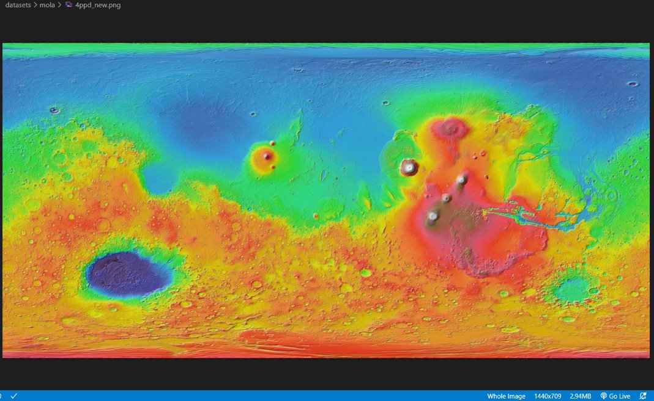

Slide 10
Data: Source and Characteristics
2. HiRISE (High-Resolution Imaging Science Experiment)
Source: ​
HiRISE is a camera on board NASA's Mars Reconnaissance Orbiter (MRO), which has been orbiting Mars since 2006. ​​
Characteristics: ​
Purpose: Captures extremely detailed surface imagery of Mars​
Data Type: High-resolution optical images, including both grayscale and color imaging. ​

Slide 11
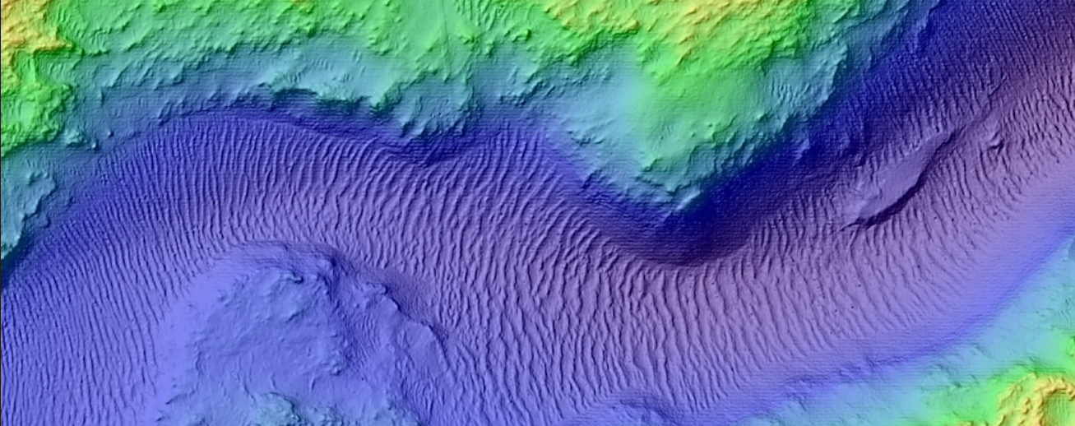

Slide 12
Data: Source and Characteristics
3. CRISM (Compact Reconnaissance Imaging Spectrometer for Mars)
Source: ​
Mars Reconnaissance Orbiter, operated by NASA, with data accessible via JHU APL CRISM website. ​
Characteristics: ​
Purpose: Locates minerals and identifies regions of interest for signs of water or volcanic activity. ​
Resolution: 18 meters per pixel in high resolution mode, 200 meters per pixel in mapping mode.
I used a 1-2 m per pixel data for ice deposits calculation.

Slide 13
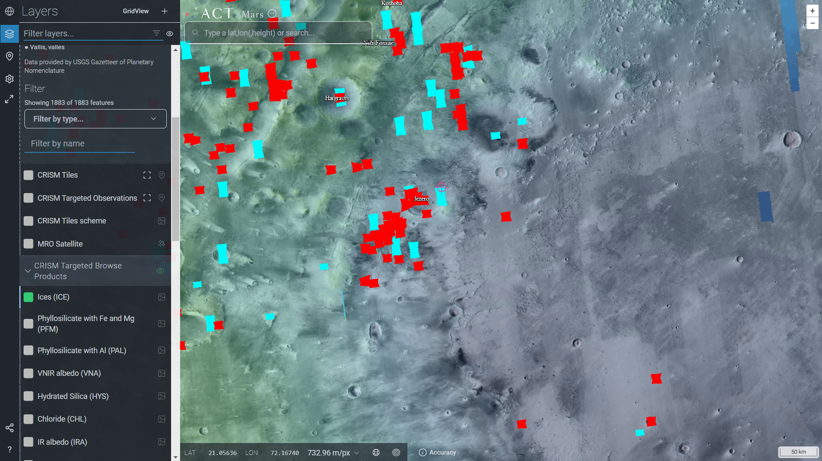

Slide 14
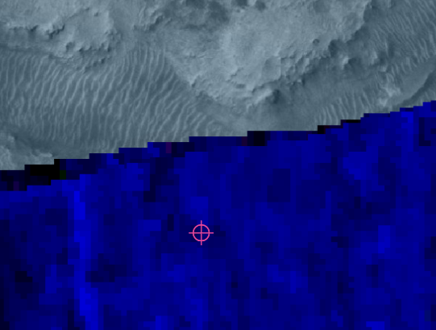

Slide 15
Assumptions

Slide 16
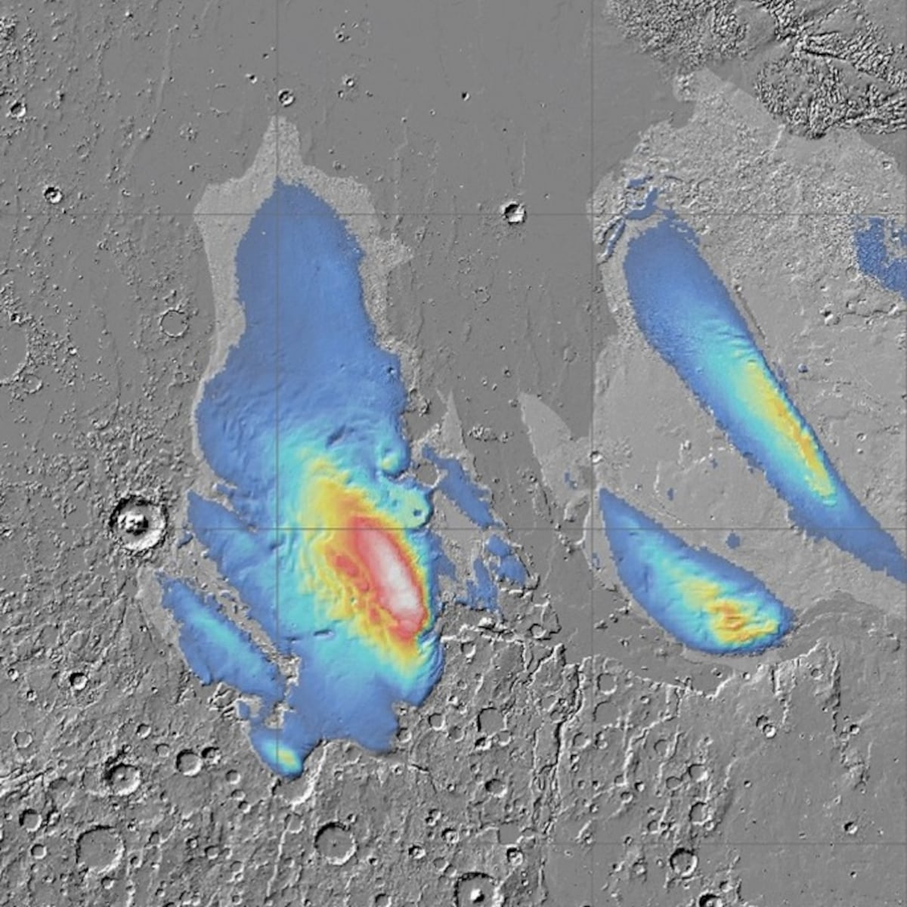
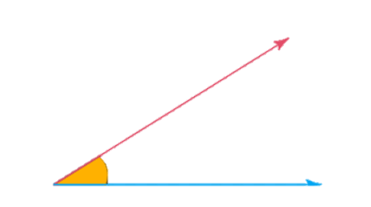
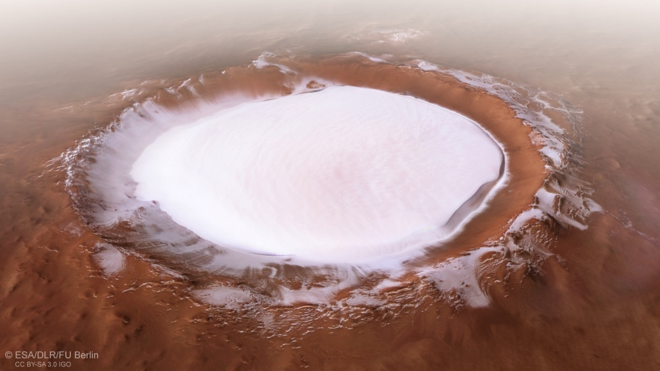
Landing Sites​
Criteria for landing sites include ​
Low Slope ​
Minimal Elevation Changes ​
Proximity To Water Ice Deposits​
Scientific Interest ​
​
Scientific interest refers to the proximity to important artifacts like ice deposits, important rocks and craters.

Slide 17
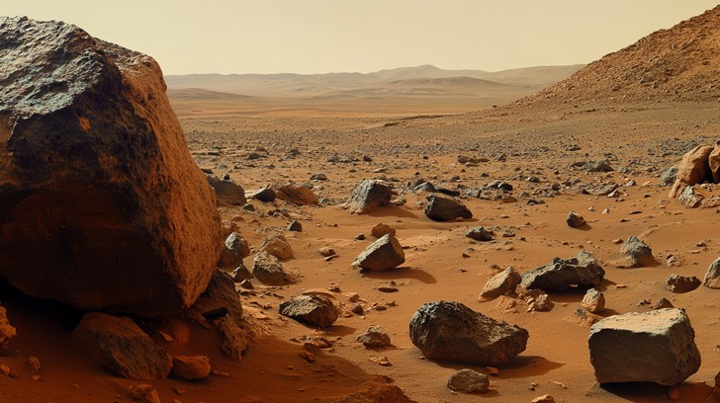
Rover Path​
The path the rover for which this trajectory is being computed is subject to the following assumptions: ​
The rover must avoid: ​
Steep slopes ​
Obstacles (rocks and craters)

Slide 18
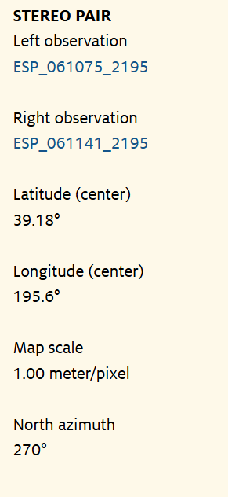
Assumptions on Precision​
The extent to which we can estimate the trajectory precisely is dependent on the data publicly available from Mars missions.
The ones with the highest resolution (like HiRISE) are limited to 1 meter at most places. This would be the limit when calculating the trajectory.

Slide 19
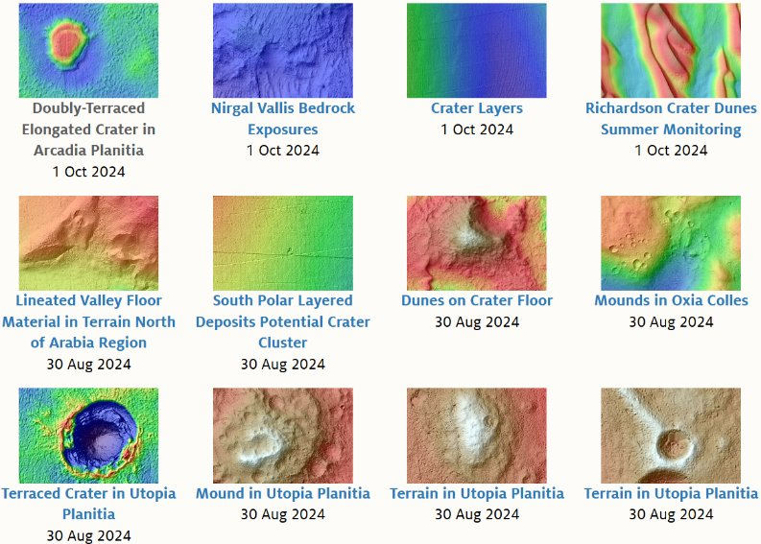
Assumptions on Extent and Extensibility
Data for the entirety of the Martian surface is not available and hence given any two random points, we would be able to generate the trajectory only if all data is present. ​

Slide 20
Results until mid evaluation

Slide 21
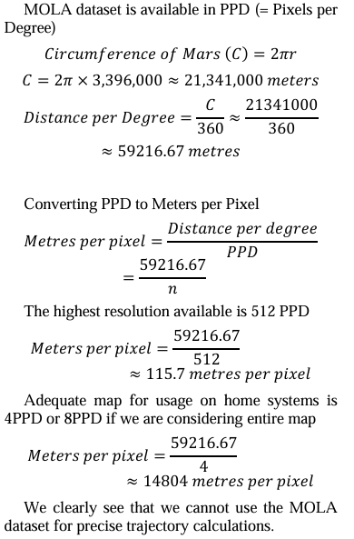
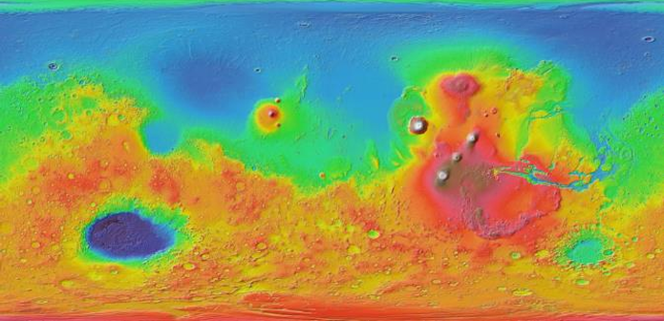
Extraction of MOLA datasets and identification of problems with using it for path planning.

Slide 22
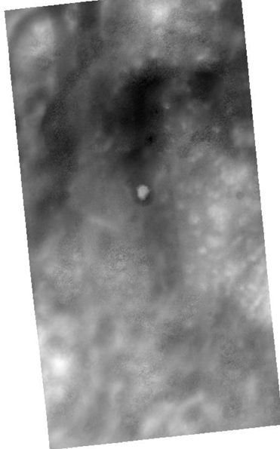
Switch to HiRISE dataset and extracting important features

Slide 23
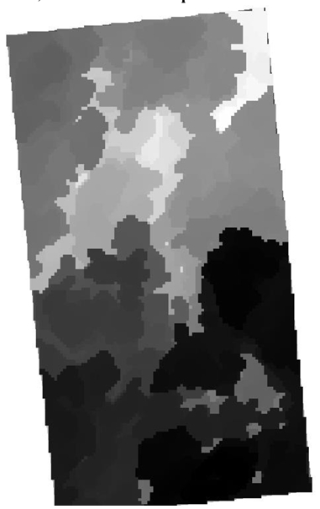
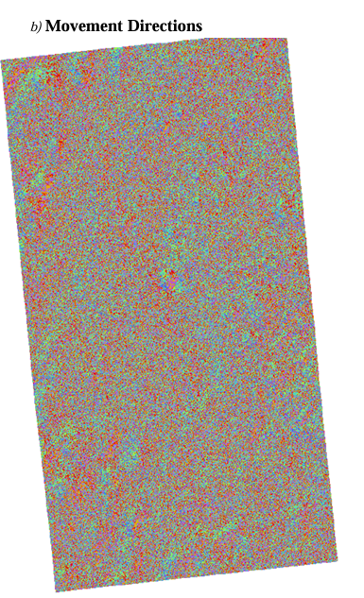
Cumulative Cost Map
Movement Directions

Slide 24
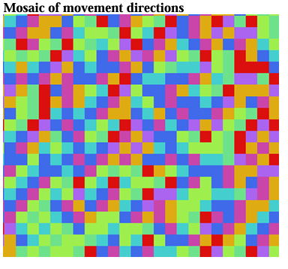
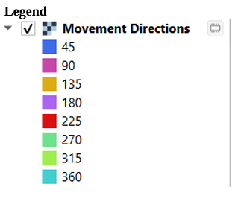

Slide 25
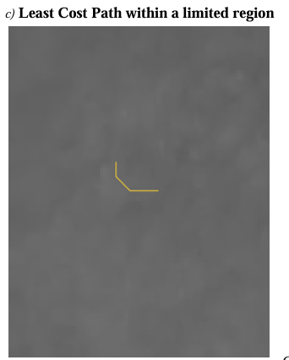
Basic Least Cost Path
Computed using 𝑟.𝑑𝑟𝑎𝑖𝑛 for a small region for proof of concept. Larger regions require much more time. There are about 3250 pixels in this region

Slide 26

Implementation of the Path Planning Algorithm
A DTM is a raster who's each pixel holds a value / some values. Usually the first (and only) value is the elevation of a point on the DTM.
High Resolution DTM are larger. Large enough that it theoretically takes my machine about thirty minutes to generate a brute-force graph (using pairs) for a 70 𝑚 ∗ 70 m.

Slide 27
Implementation of the Path Planning Algorithm
This brute force method makes large scale computation slower but gives the same.
The idea is to implement a dense graph of the same size as the DTM however with a different shape.

Slide 28
Implementation of the Path Planning Algorithm
Val
Val
Left Cost
Top Cost
Right Cost
Bottom Cost

Slide 29
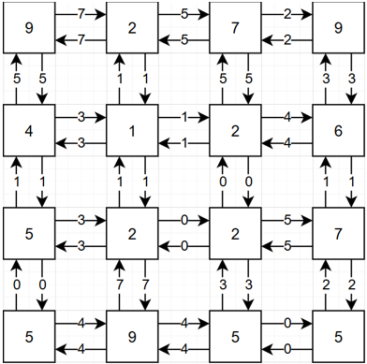
Implementation of the Path Planning Algorithm
Val
Val
Left Cost
Top Cost
Right Cost
Bottom Cost

Slide 30
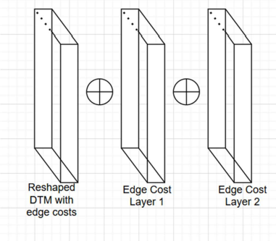
Combining two (or more) “weights layer(s)”
The code to compute the trajectory relies on weights layers.
These have the edge costs to be added.
All computation is vectorized and be simply superimposed using some function, most simply addition.

Slide 31
Now we have the nodes and the edges costs

Slide 32
We would apply Dijkstra to calculate the optimal path. (All edges costs are constrained to non-negative numbers)

Slide 33
Avoiding Danger Zones
The code to compute the trajectory relies on weights layers.
These have the edge costs to be added.
All computation is vectorized and be simply superimposed using some function, most simply addition.

Slide 34
Affinity Points
The code to compute the trajectory relies on weights layers.
These have the edge costs to be added.
All computation is vectorized and be simply superimposed using some function, most simply addition.

Slide 35
Processing Raster Data from CRISM Dataset Using Image Processing
Let’s look at this beautiful image of a region in Mars at the coordinates: 18.69° 𝐿𝐴𝑇, 78.15° 𝐿𝑂N

Slide 36
CRISM Data for ICE deposits
Let’s look at this beautiful image of a region in Mars at the coordinates: 18.69° 𝐿𝐴𝑇, 78.15° 𝐿𝑂N

Slide 37
CRISM Data for ICE deposits
The ice deposits layer is in blue.

Slide 38
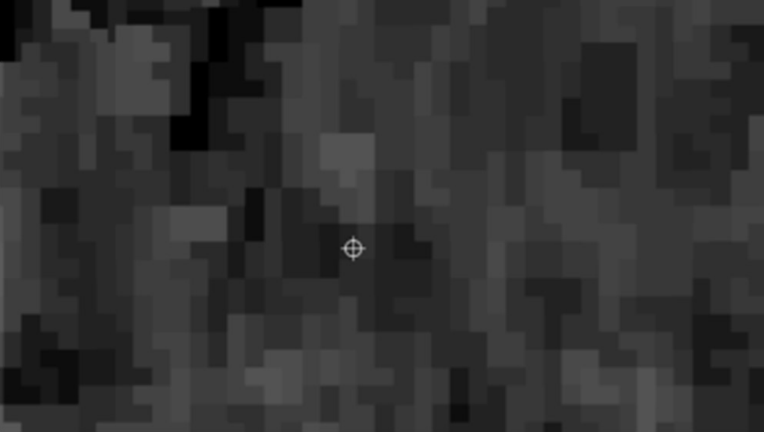
CRISM Data for ICE deposits
Grayscale version of the image

Slide 39
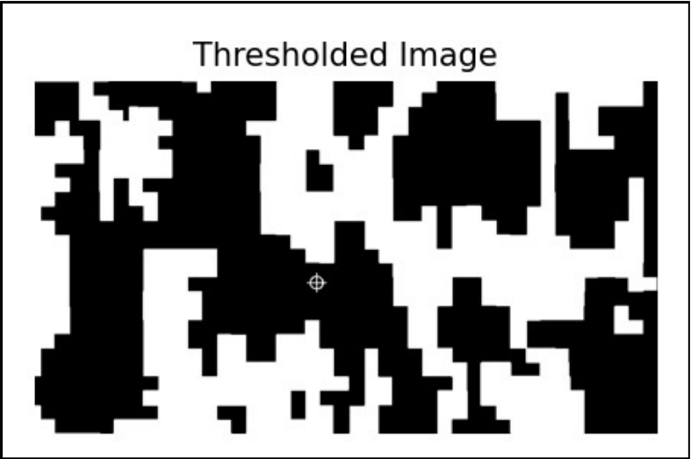
Image Processing of CRISM data: Step 1
Threshold applied on the image to get the significant regions.

Slide 40

Image Processing of CRISM data: Step 2
Closing morphological operation applied to get significant clusters

Slide 41
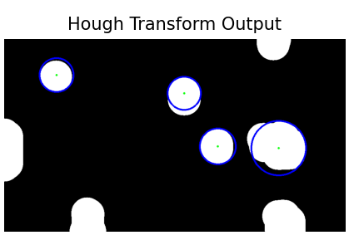
Image Processing of CRISM data: Step 3
Hough Circles applied to get the coordinates.

Slide 42
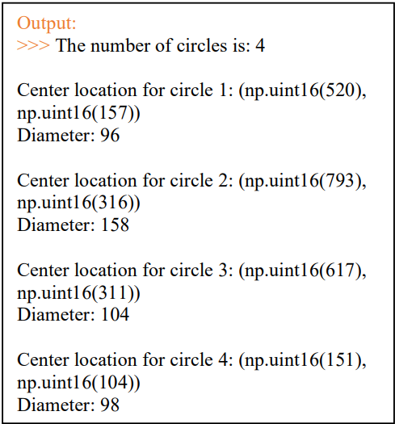
Image Processing of CRISM data: Step 3
Hough Circles applied to get the coordinates.

Slide 43
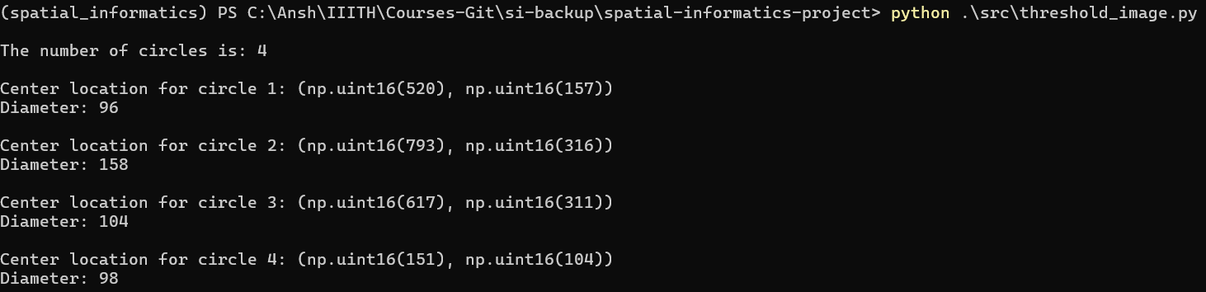
Image Processing of CRISM data: Step 3
Hough Circles applied to get the coordinates.

Slide 44
3D Visualizer!!

Slide 45
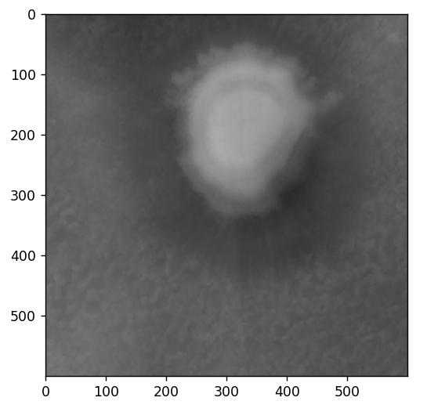
A 3D visualizer to visualize the DTM and the path generated.

Slide 46
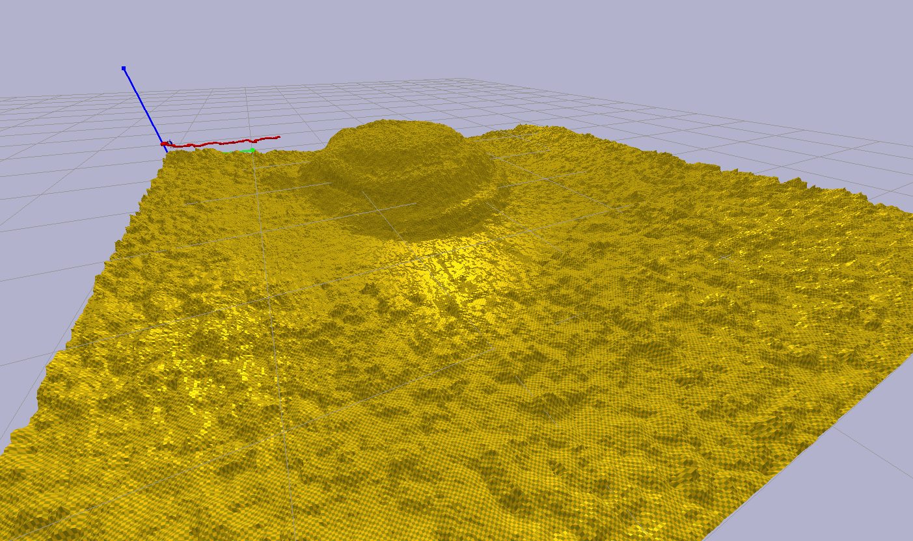
A 3D visualizer to visualize the DTM and the path generated.

Slide 47
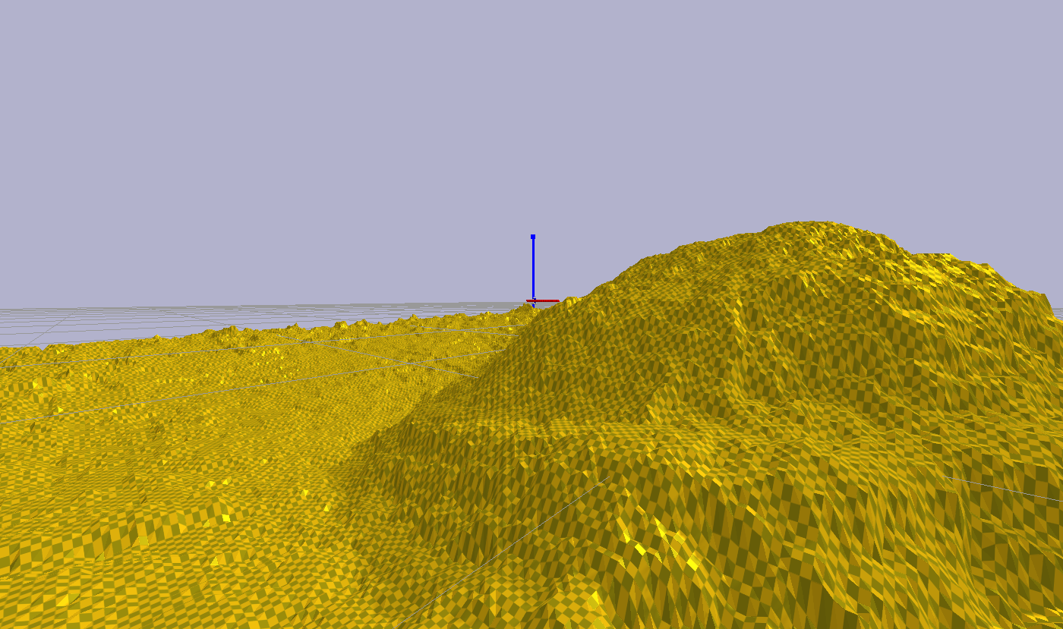

Slide 48
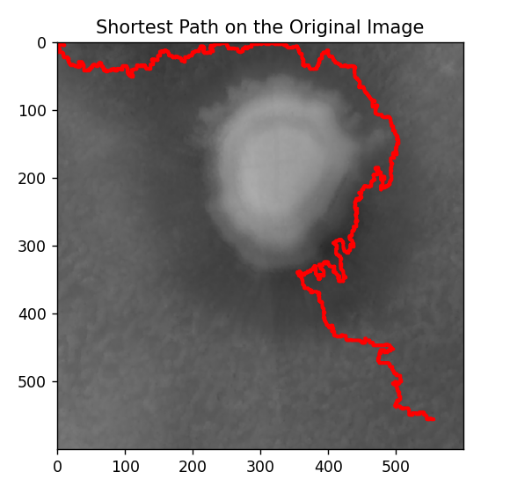
Path generated

Slide 49
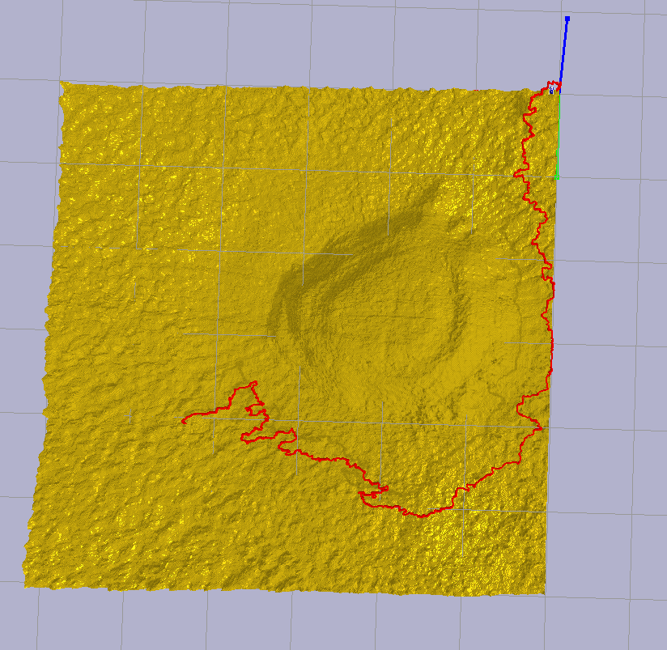
Path generated

Slide 50
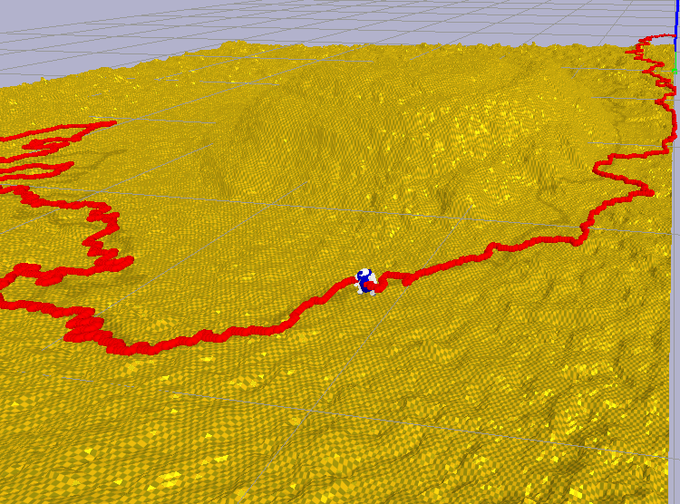
Path Visualization of the Mars Rover Traversing the surface. (**some bugs exist)

Slide 52
Live Demonstration

Slide 53
Spatial Methods Used

Slide 54
Spatial Methods used for Mid-Evaluation Objectives
Raster Reprojection
Georeferencing
Cost Surface Analysis - Cumulative Cost Mapping
Cost Surface Analysis - Movement Direction Mapping
Spatial Extent Definition
Least-Cost Path Analysis

Slide 55
Spatial Methods used for Final Objectives
Multi-Raster Analysis
Thresholding
Morphological Operations
Hough Circles
And more implicitly

Slide 56
Special Characteristics
A good chuck of my code is vectorised.
This makes it better than some computations done by QGIS which is incredibly slow and does not utilise the GPU.
The 3D visualisation is also fast to generate.

Slide 57
Limitations
Coarseness of data and prone to error
The data used for calculating the main trajectory is taken from the HiRISE dataset.
This is the highest resolution available to us. However, this is still 1m per pixel, making it hard for small rovers to navigate accurately based on the terrain data.
However, big robots with bigger wheels would have less problems with this.

Slide 58
Limitations
2. Slow speed for plotting path
The overlayed path on the 3D visualization takes a while to plot because individual elements in the environment are created. This can be reduced by using prefabs.

Slide 59
Limitations
3. Inaccurate physics for the Mars rover
Due to resource constraints, I was not able to achieve very accurate physics of the rover while it traverses the terrain. Hence, I made the robot make a flyby just over the terrain in a sequential manner to simulate the process.

Slide 60
Limitations
4. Only includes support for Raster Data
My project only includes support for raster data to be included to calculate the trajectory of the rover. Any vector data needs to be rasterized (leading to some possible errors in the process)

Slide 61
All code hosted on GitHub
https://github.com/anshium/spatial-informatics-project

Slide 62
Resources
In addition to the sources of data mentioned previously,
https://mars.quickmap.io/
was helpful for CRISM data.

Slide 63
Resources
In addition to the sources of data mentioned previously

